Slide 1
Simulation of Honeycomb Structures under Compression, Bending, and Torsion
Tianyi Wang, Zhicheng Ren

Slide 2
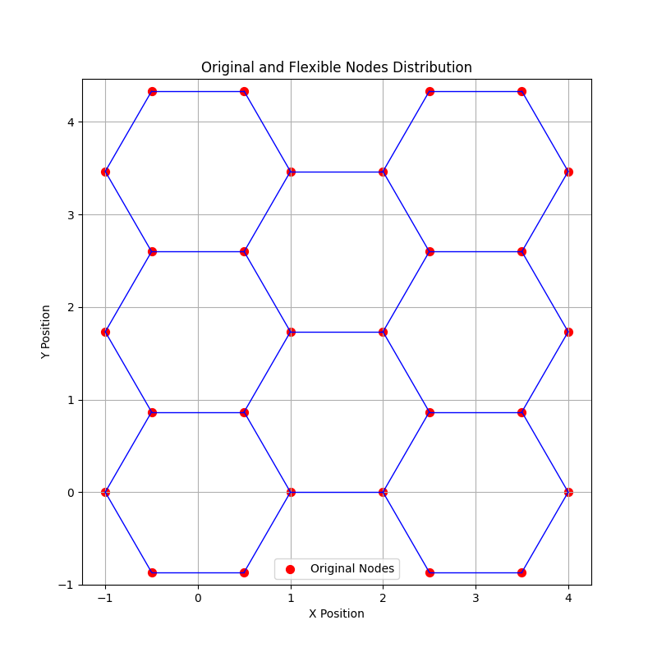
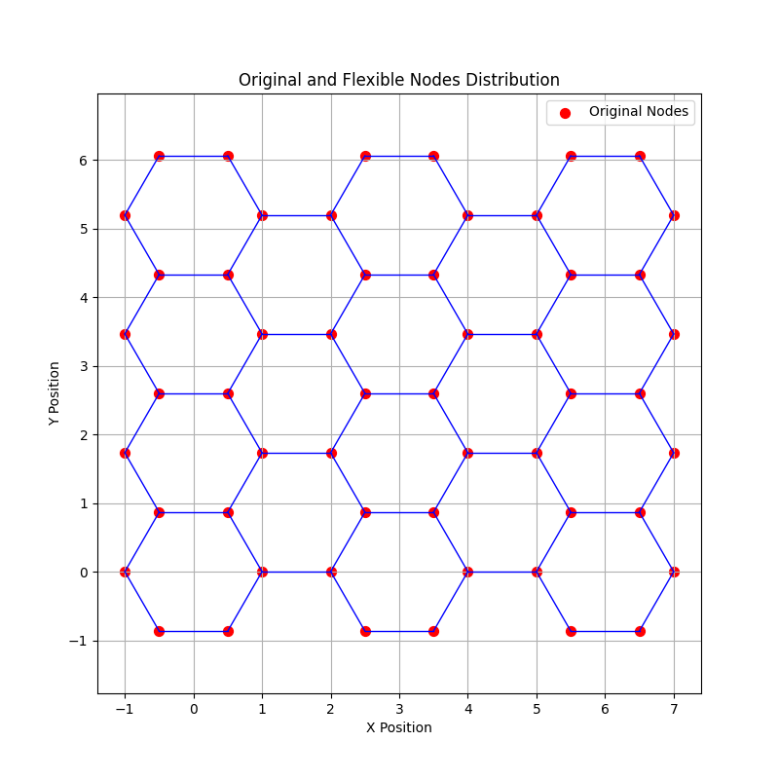
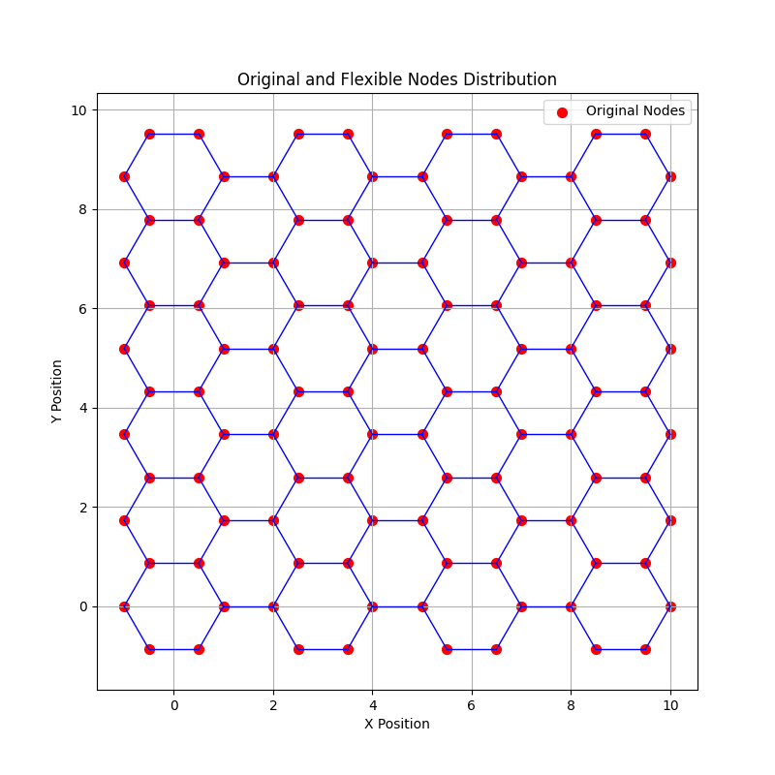
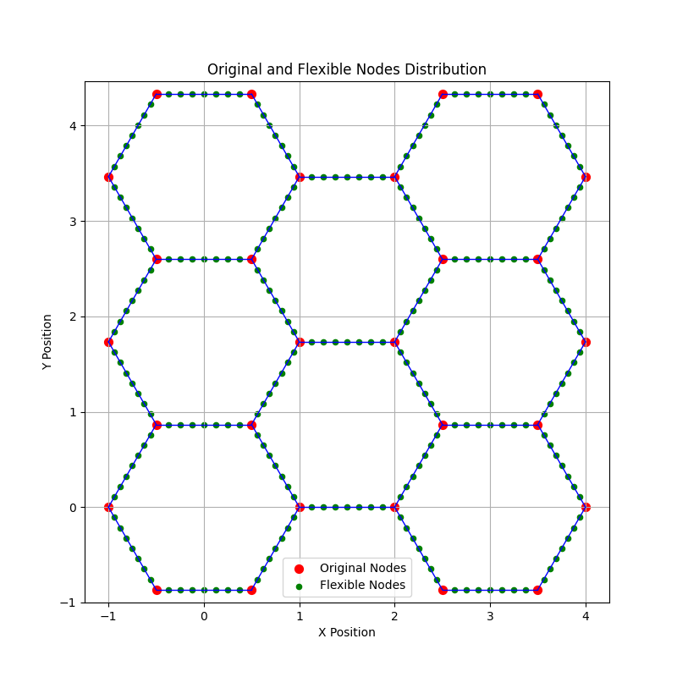
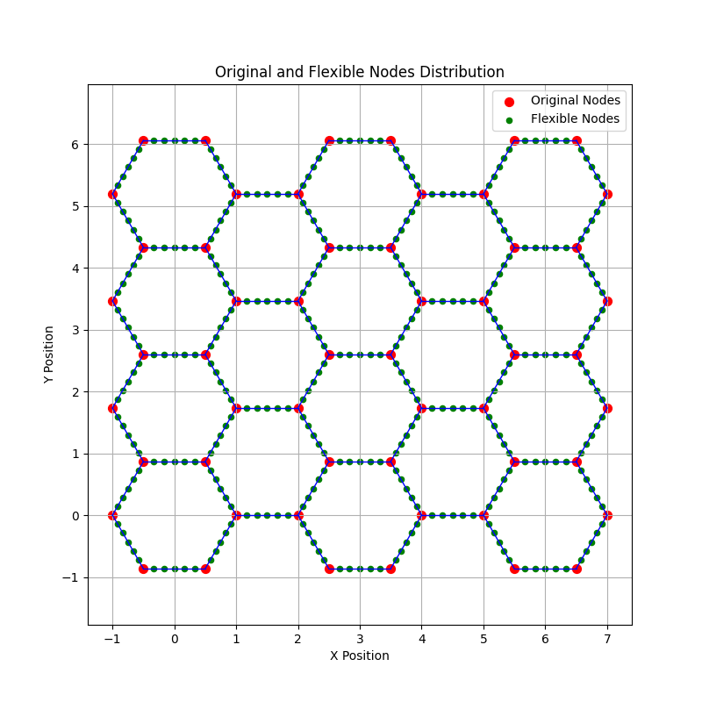
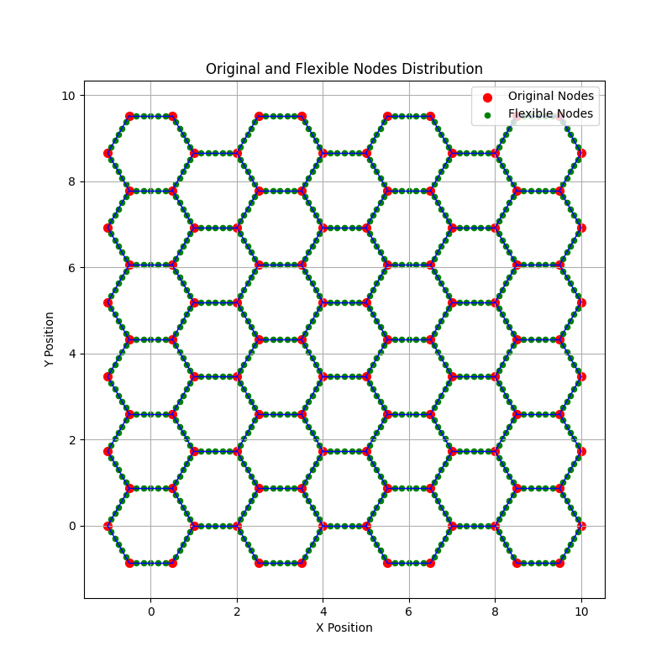
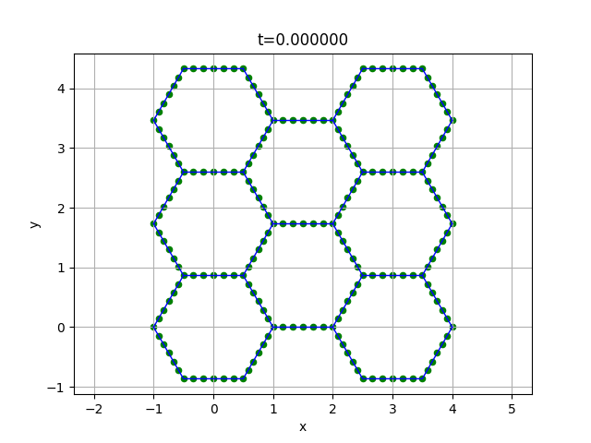

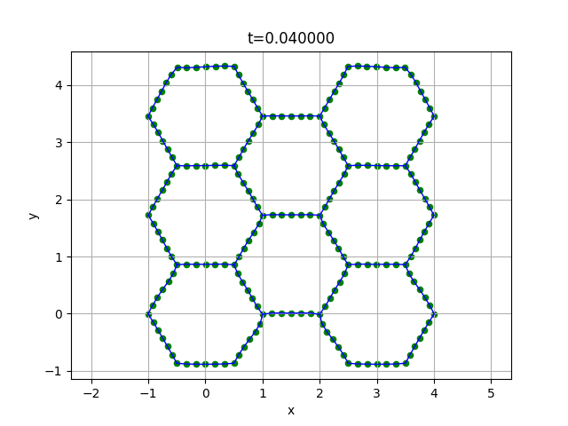
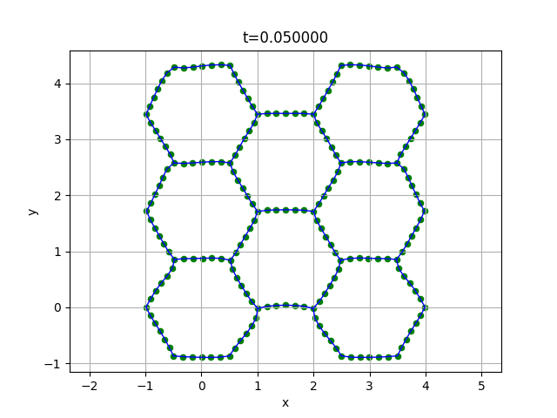
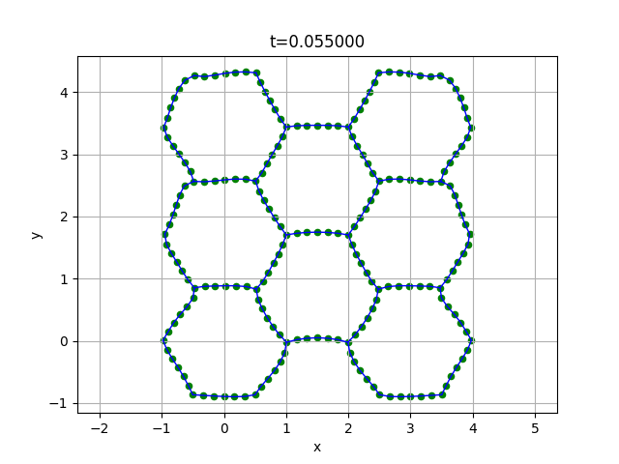
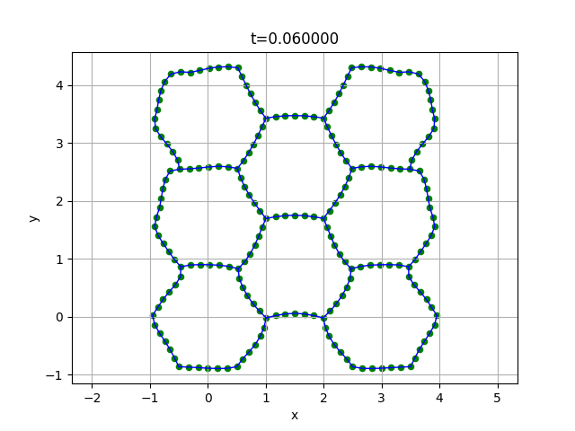
So far…
A few helper functions added:
Honeycomb structure generator
Flexible nodes generator
…
Challenges: critical nodes, large matrix
Trial simulation:

Slide 3
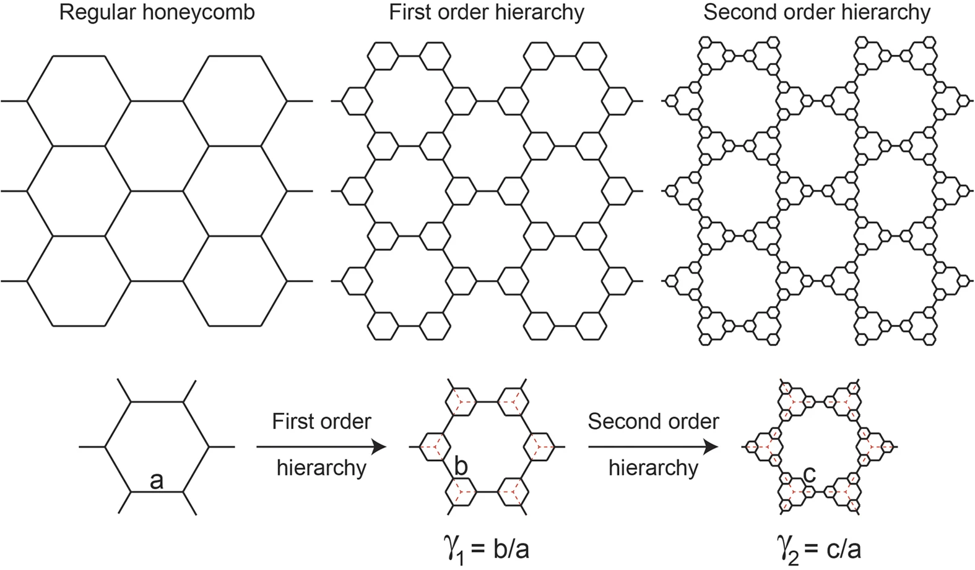
Still ongoing…
Debug and finalize our model
Evaluate the mechanical behavior of honeycomb structures with varying cell counts and wall thicknesses
Explore improvement and optimization for hybrid structures

Slide 4
Reference
Aminanda, Y., B. Castanié, J.J. Barrau, et al. "Experimental Analysis and Modeling of the Crushing of Honeycomb Cores." Applied Composite Materials, vol. 12, 2005, pp. 213–227.
Asprone, Domenico, et al. "Statistical Finite Element Analysis of the Buckling Behavior of Honeycomb Structures." Composite Structures, vol. 105, Nov. 2013, pp. 240–255.
Mousanezhad, D., S. Babaee, H. Ebrahimi, et al. "Hierarchical Honeycomb Auxetic Metamaterials." Scientific Reports, vol. 5, 2016, article 18306. Nature, https://doi.org/10.1038/srep18306.
Partovi Meran, Ahmad, et al. "Numerical and Experimental Study of Crashworthiness Parameters of Honeycomb Structures." Thin-Walled Structures, vol. 78, May 2014, pp. 87–94.
Papka, S.D., and S. Kyriakides. "Experiments and Full-Scale Numerical Simulations of In-Plane Crushing of a Honeycomb." Acta Materialia, vol. 46, no. 8, 1 May 1998, pp. 2765–2776.
Qi, Chang, et al. "Advanced Honeycomb Designs for Improving Mechanical Properties: A Review." Composites Part B: Engineering, vol. 227, 15 Dec. 2021, article 109393.
Yamashita, M., and M. Gotoh. "Impact Behavior of Honeycomb Structures with Various Cell Specifications—Numerical Simulation and Experiment." International Journal of Impact Engineering, vol. 32, nos. 1–4, Dec. 2005, pp. 618–630.

